Slide 1
E-commerce – olist store analysis
Presented By
Ameya Vaidya

Slide 2
INDEX
KPI5
Average of shipping days V/S review score
KPI4
Average Price And Payment Value Of Sao Paula City
KPI3
Average Number Of Days Taken To Deliver For Pet Shop
KPI2
Number Of Orders By Review Scores And Payment Type
KPI1
Weekday vs Weekend Payments

Slide 3
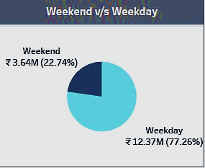
KPI 1
Weekday vs Weekend Payments
ANALYSIS
The analysis of payment data reveals that weekday payments (₹12,367,988) significantly outweigh weekend payments (₹3,640,884). To increase sales during weekends, it is crucial to understand the factors contributing to the discrepancy. Potential observations could include lower footfall or reduced customer engagement on weekends, leading to fewer purchases. Additionally, pricing strategies or promotional activities may not be optimized for attracting customers during weekends.
Suggestions for improving sales with lower weekend payments
Promotional Campaigns
Special Weekend Offers
Enhance In-Store Experience
Collaborations and Events
Customer Feedback and Adaptation

Slide 4
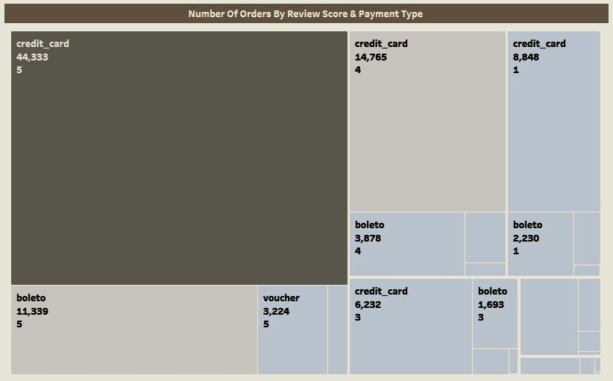
KPI2
Number Of Orders By Review Scores And Payment Type
ANALYSIS
Convenience and Trust
Seamless Transactions
Affluent Customer Base
Suggestions for maximizing orders with a review score of 5 and credit card payment
Focus on Payment Options
Enhance Customer Service
Offer Incentives for Reviews
Continuous Improvement

Slide 5
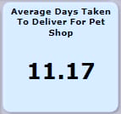
KPI3
Average Number Of Days Taken To Deliver For Pet Shop
OBSERVATION
The average delivery time of 11.17 days indicates that, on average, customers receive their orders within approximately 11 days after placing them.
ANALYSIS
Delivery Efficiency
Delivery Location and Distance
Courier Services
Order Processing and Packaging
Customer Expectations
Suggestions for improving delivery times
Optimize Order Processing
Shipping Method Selection
Clear Communication
Continuous Improvement

Slide 6
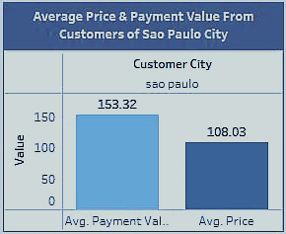
KPI4
Average Price And Payment Value Of Sao Paula City
OBSERVATION
The average price of 108.03 indicates the typical amount customers spend per purchase in Sao Paulo. On the other hand, the average payment of 153.32 suggests that customers tend to make payments exceeding the average price, possibly due to additional items, delivery fees, or higher-priced products.
ANALYSIS
Pricing Strategy
Customer Preferences
Upselling and Cross-selling Opportunities
Delivery Fees and Additional Charges
Customer Affluence and Spending Power
Suggestions for optimizing sales and payments
Product Bundles and Discounts
Personalized Recommendations
Loyalty Programs
Convenient Payment Options
Customer Feedback and Engagement

Slide 7
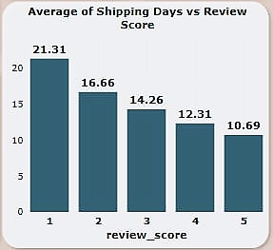
KPI5
Average of shipping days V/S review score
OBSERVATION
The data shows a consistent pattern where higher review scores are associated with shorter shipping days. As the review score increases, the average shipping days decrease.
ANALYSIS
Customer Satisfaction
Efficient Order Processing
Communication and Expectations
Logistics and Delivery Partners
Suggestions for improving shipping days and review scores
Optimize Order Fulfillment
Expedited Shipping Options
Enhance Logistics Management
Clear Communication Channels
Continuous Improvement

Slide 8
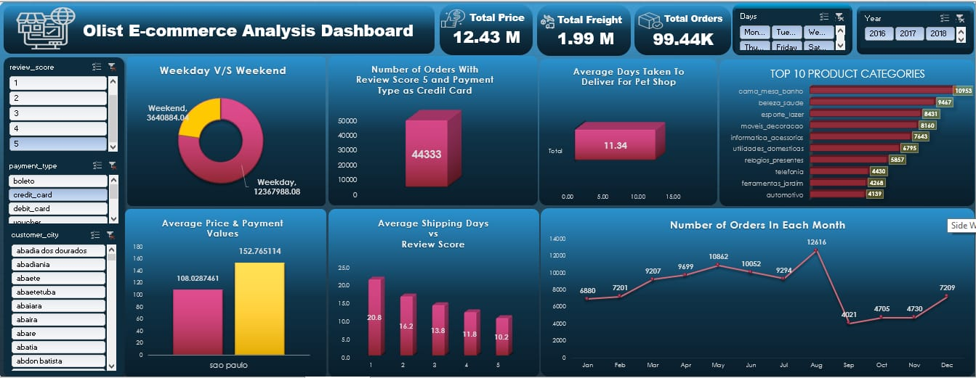
EXCEL DASHBOARD

Slide 9
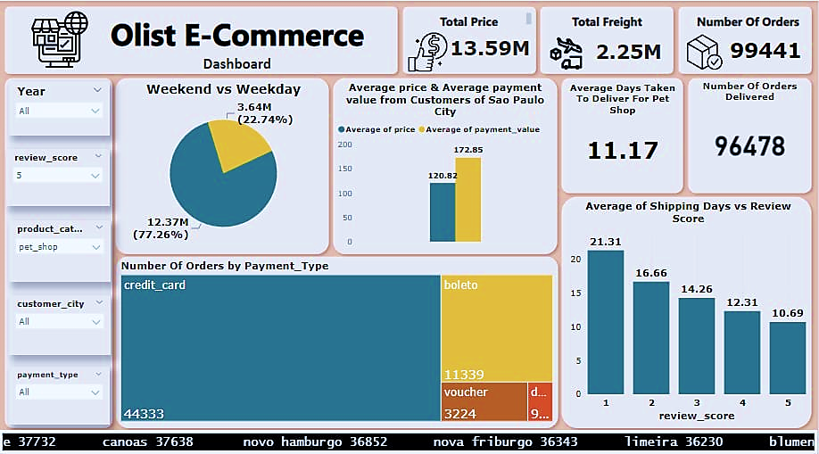
POWER BI DASHBOARD

Slide 10
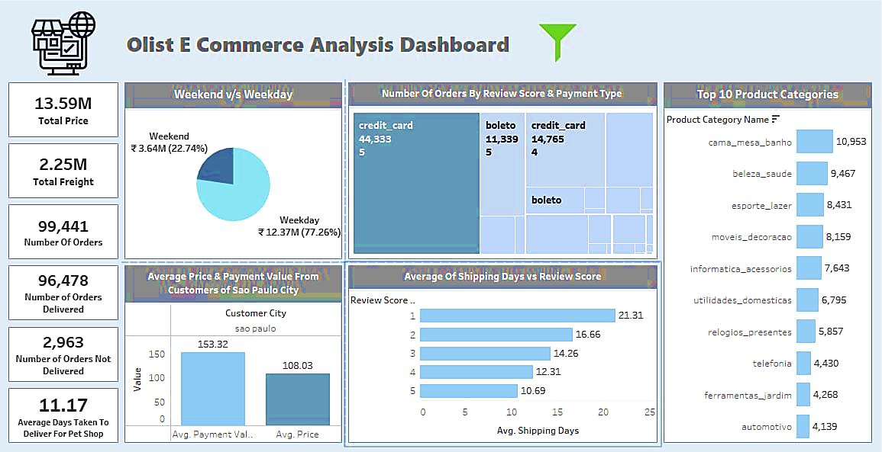
TABLEAU DASHBOARD

Slide 11
CONCLUSION
Numerical variables like price, payment value, and freight value were crucial for analyzing product performance and understanding user behavior
Olist's focus on customer satisfaction is evident through positive user reviews across various product categories.
Developing new features was essential for conducting time series analysis and gaining deeper insights.
Sao Paulo emerged as a significant contributor to revenue, user base, and positive user reviews, with most shopping activity occurring on weekdays.
Security services received below-average user reviews, while overall product quality was rated above average at around 4 stars.
Data cleanliness and standardization are crucial for accurate analysis and to align with our intended goals. Proper data cleaning processes must be implemented to remove inconsistencies and ensure the data is reliable for meaningful insights and decision-making.
Analyzing average delivery days and the relationship between shipping days and review scores revealed insights into the company's delivery performance, guiding improvements for timely deliveries and enhanced customer satisfaction.
Utilizing the project findings, businesses can tailor marketing strategies by understanding customer preferences, spending patterns, and geographic insights. This enables targeted promotions and optimized marketing efforts to maximize results and drive customer engagement.

Slide 12


